Slide 1
AngularJS
AngularJS
Lecture 1
By James(Jin) Wang
08/01/2019

Slide 2
Outline
Big Picture
Views, Directive and Filters
Controllers, Scope and Modules
Routing
Services and Factories
Animation

Slide 3
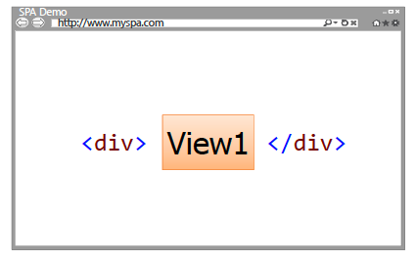
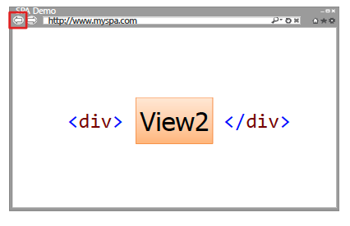
Big Picture
  SPA Overview:
  SPAs allow different views to be loaded into a shell page as the user interacts with the page
  Views can be replaced with other views
  SPAs maintain a history of views that have been displayed

Slide 4
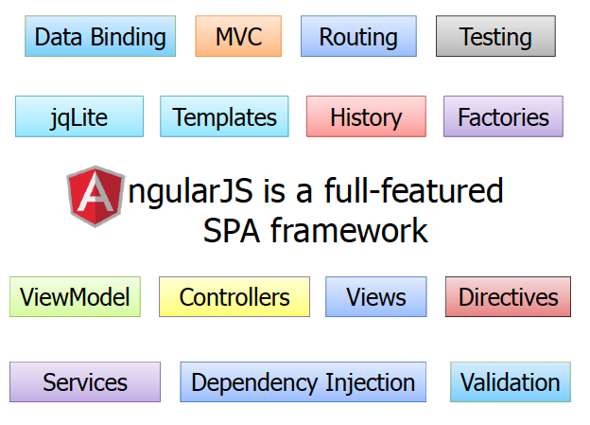
Big Picture
  Full-featured SPA Framework:

Slide 5
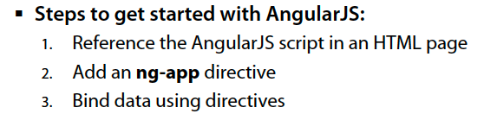
Big Picture
  Getting Started with AngularJS:

Slide 6
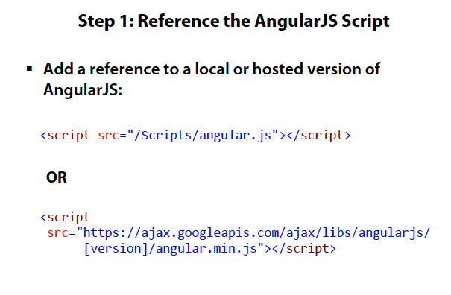
Big Picture

Slide 7
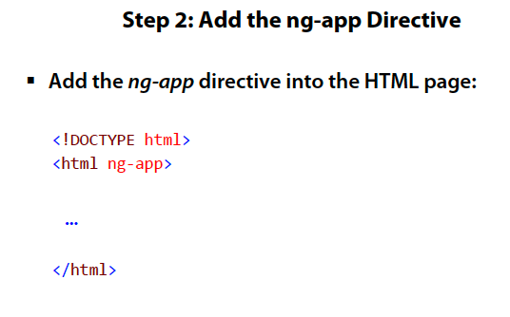
Big Picture

Slide 8
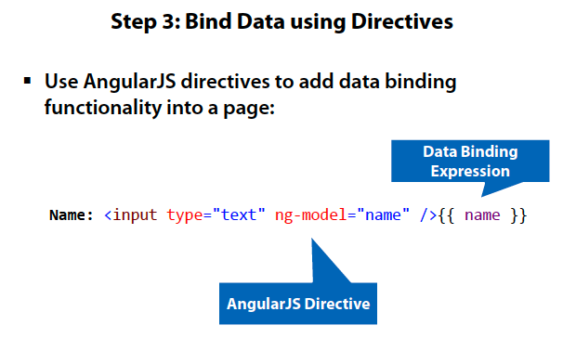
Big Picture
  AJS Demo: HelloWorld

Slide 9
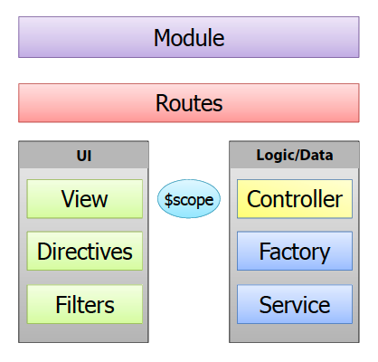
Big Picture
  Key Players in AngularJS:

Slide 10
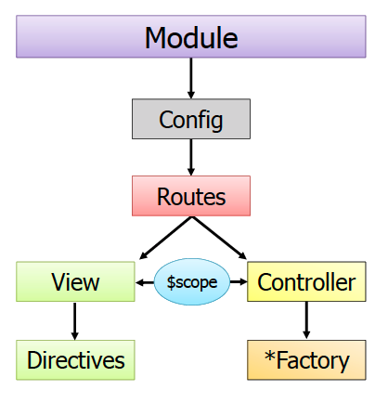
Big Picture
  The Big Picture:

Slide 11
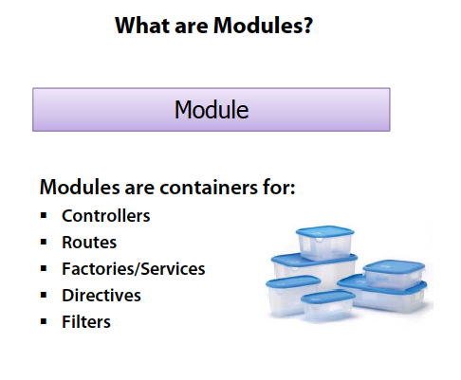
Big Picture

Slide 12
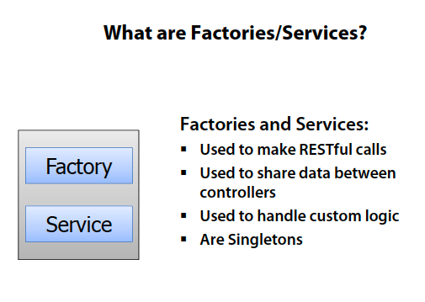
Big Picture

Slide 13
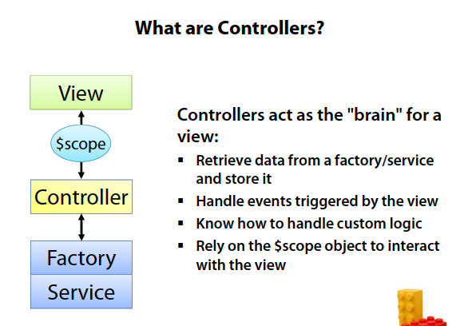
Big Picture

Slide 14
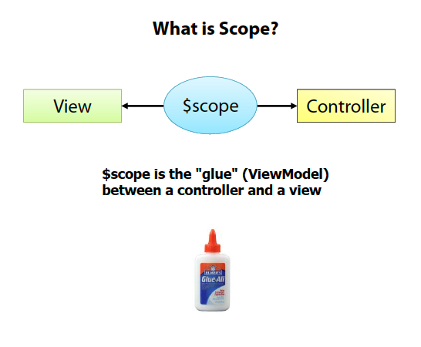
Big Picture

Slide 15
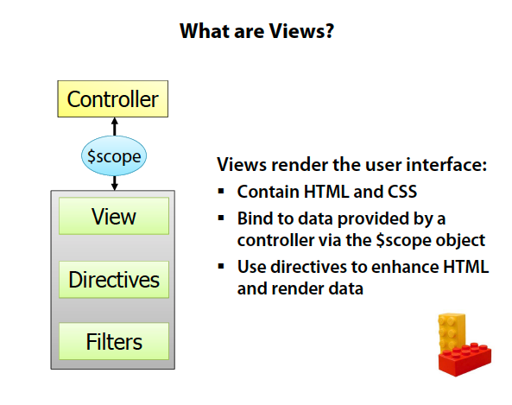
Big Picture

Slide 16
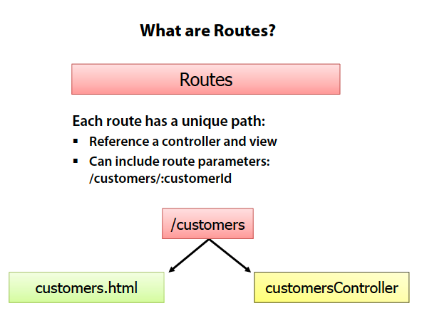
Big Picture

Slide 17

Big Picture
  https://docs.angularjs.org/api

Slide 18
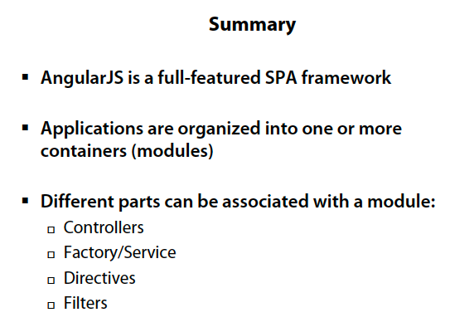
Big Picture

